Slide 1
Course : Computational Physics
Effective Period : April 2022
Simulating Basic RLC Rectifier Circuits

Slide 2
Objective and Outline
LO : Implement a computational simulation of basic electrical circuits using Python programming language
In this course we will be simulating power electronic circuits using Python. However, the Python part is not heavy. This course is ideal for students only with a basic knowledge of network theory and programming to get started with simulating simple power electronic circuits. The course contains a basic introduction to the Python Power Electronic (PPE) and describes how to use it to simulate simple rectifier (RLC) circuits.
In this session, we will start exploring a simulation concept using Open-Source Python Power Electronics
Download : https://www.pythonpowerelectronics.com/
Outline
Adding an Inductor to a basic RC Rectifier circuit
Analysis of basic Rectifier circuit and energy storage
Analysis of the rectification output graph

Slide 3
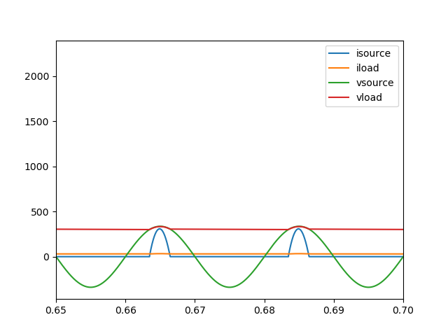


Inductor
The nature of an inductor, or induced EMF is a function of the derivative of current. Larger the rate of change of current, greater will the EMF produced to oppose it. Inductors therefore oppose current and used when the intention is stop currents from rapidly changing.
When the load is connected, the load voltage follows the voltage source, therefore load voltage is uncontrollable.
An inductor will therefore not allow the current through it to change rapidly due to the integral action. This makes them ideal candidate as current limiters, otherwise it will fairly messy. Like in a heavy rain, we can't let our reservoir flooded

Slide 4
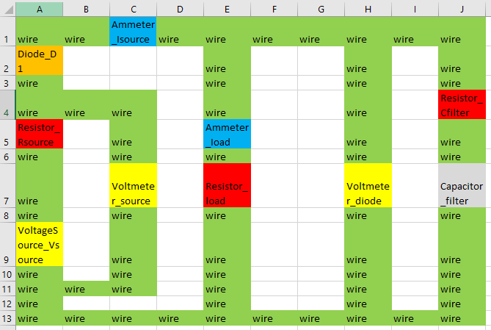
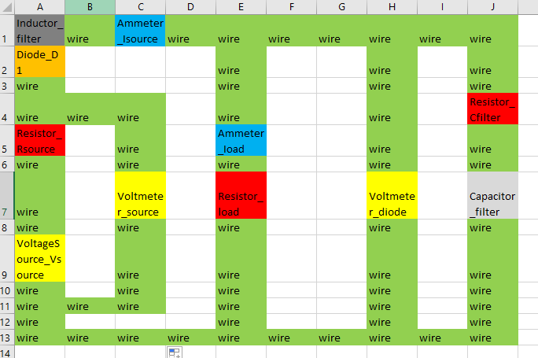
Simulating Basic RLC Rectifier Circuits
Open MS Excel and recreate the circuit design
Rules: ComponentType_ComponentName and its case sensitive.
Copy and update last’s weeks circuit in basic .CSV file → e.g D:\...\simulations\inductor_example\inductive_rectifier.csv (this is your WORKING DIRECTORY)
In the last session we have this circuit of forward biased diode and capacitor. Now we will add an inductor to the output. Remember, an inductor always connected on between a node as a parallel branch where you want to regulate the load. Inductor can’t be used standalone with no resistance, then we need to put very small parasitic resistor

Slide 5
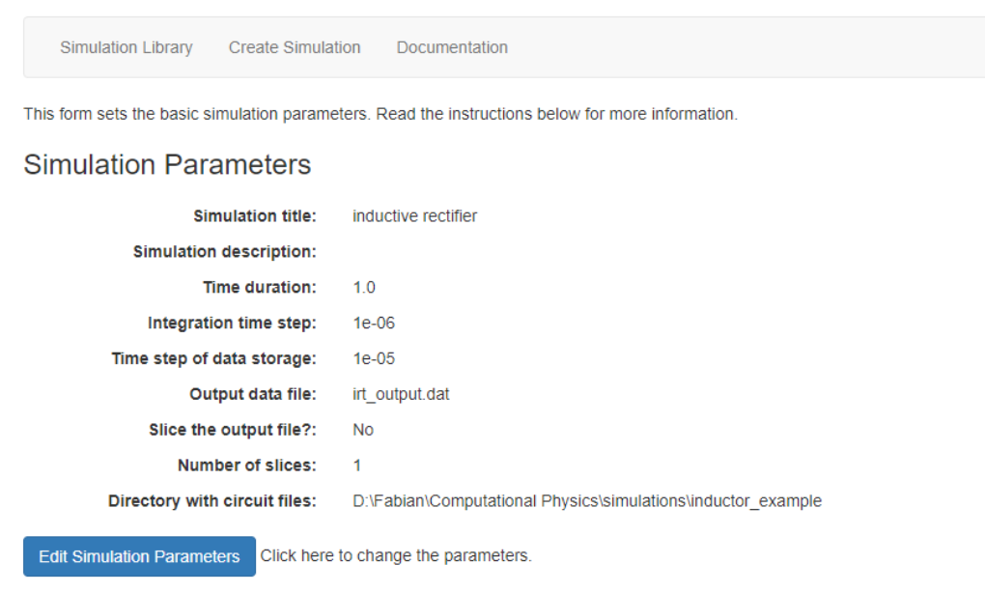
Webserver launch reminder!
Activate ppe environment
Go to manage.py folder directory (launch file)
If the structured database is already created, run the webserver by python manage.py runserver
Copy http://127.0.0.1:8000/ (or other URL) and run in your browser
Creating simulation
Run the PPE webserver
Create new simulation ‘Inductive Rectifier’, add your working directory file.
Solve the warning if there is any, save first, and you can edit later when you need it.
The smaller the integration time, the higher the sampling frequency. But longer processing time. The larger the faster, but you lose some data record

Slide 6

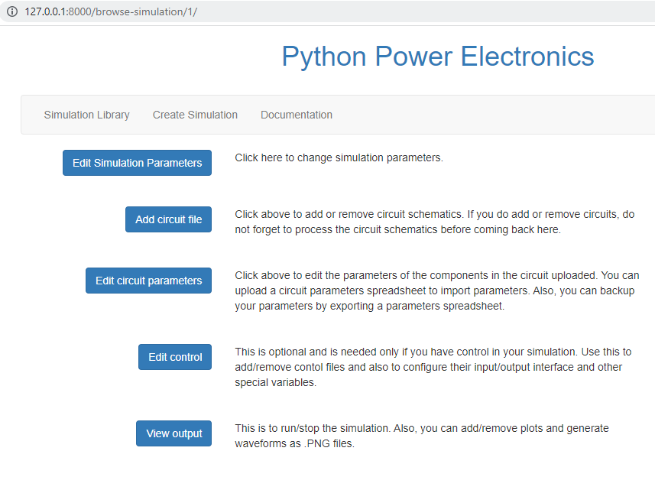
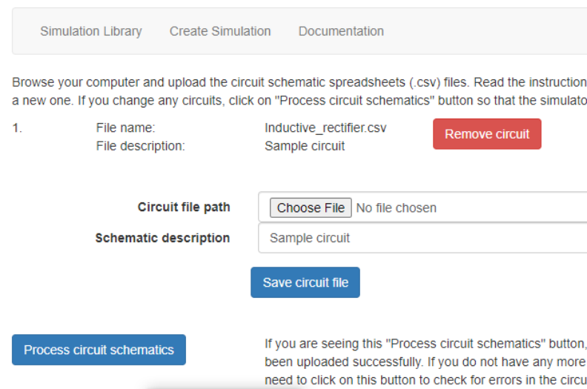
Adding minimalistic circuit simulation
Check is the testfile is created in the WORKING FOLDER
Open and understand the .CSV file structure using word editor
Go to Simulation Library → Load the Rectifier Simulation → Back to Main Page
Add circuit file → select file → safe circuit file → process circuit schematic
If error, update the .CSV file → process circuit schematic. No need to reupload
Then → Back to main page

Slide 7
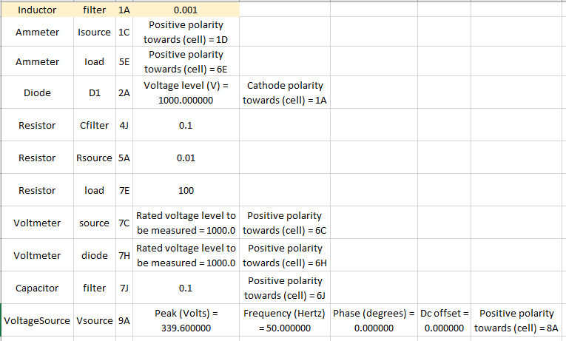
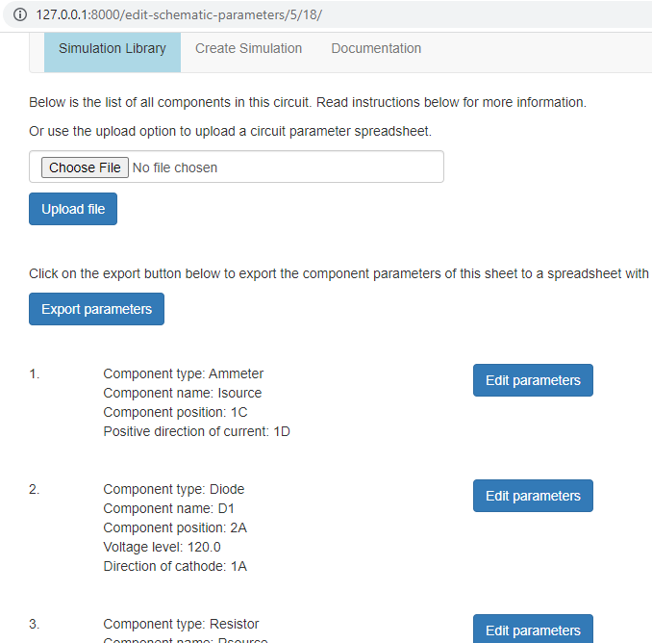
Simulating Basic RLC Rectifier Circuits
Edit Circuit Parameter
Click Edit circuit parameter → Edit parameter and change according to the parameter here.
We tried to simulate the numbers and component behaviour

Slide 8
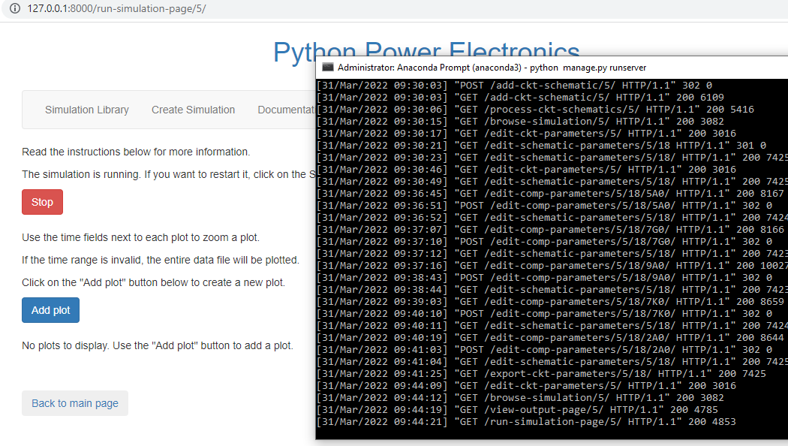
Simulating Basic RLC Rectifier Circuits
Run Simulation
Go back to the main menu → Click View output
Check if there is any error on the anaconda prompt
Run the simulation → add Plot

Slide 9
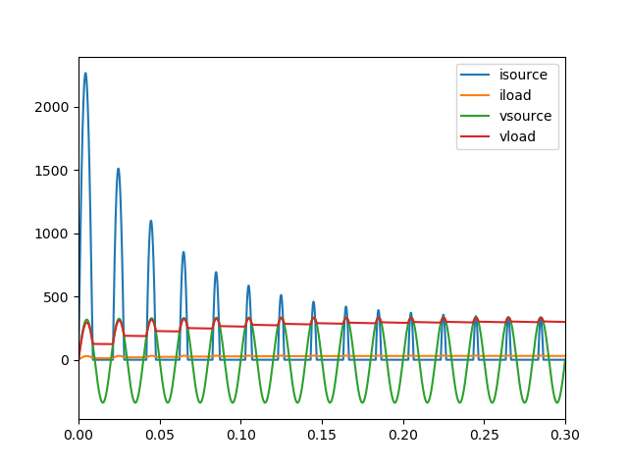
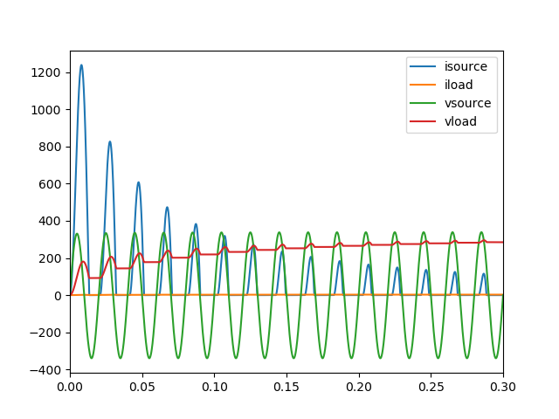
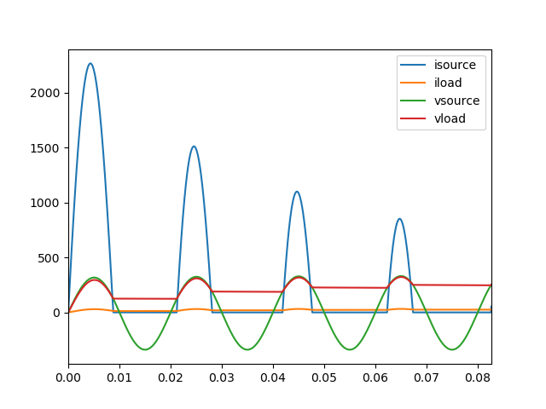
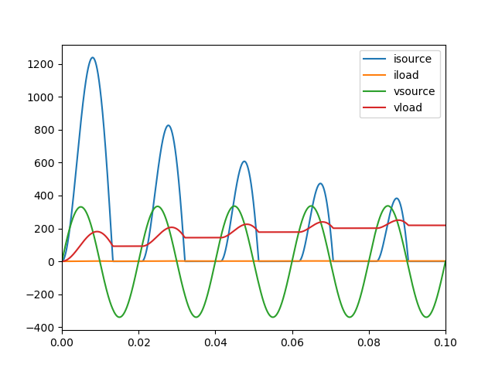
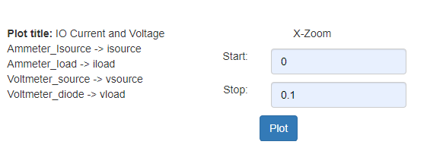

Back to main page, View Output → Run
Check for error on the cmd. Then,
Create several plot that we required
The 1st case: Inductor 0.001 H → Plot
The 2nd case:
Change Inductor to 0.003 H → Plot
Compare the two simulation plots above
When the source volt exceed the load voltage then the diode current starts conducting with forward bias but rises more gradually than before.
The diode oppose the increasing current and the load voltage becomes elongated and much smaller than source voltage

Slide 10
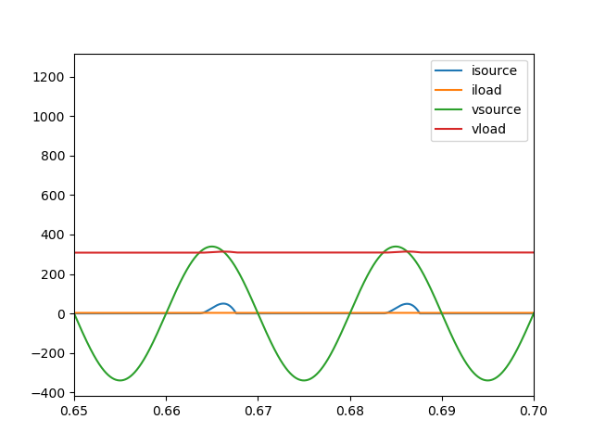
It shows the a “good enough” DC output graph
If we zoomed in to 0.65 – 0.7 on the x-axis, although its not perfect, we found that the voltage and current load are already steady positive net graph and could represent a meaningful conversion from AC to DC.
However, the early part of the graph are still considered as unstable, and the current is very low. This is might be due the capacitor used id too large and there is not enough current induced by the inductor
What will happen if we change several parameters of both capacitor and inductor. How could it affect the output?

Slide 11
Final Assignment:
Design a simple RLC Rectifier I/O simulation of your own laptop in Indonesia.
What is the value of each component, so your laptop get a good and stable DC input of Voltage and Current. Check your laptop charger (AC Adaptor) for requirements.
Example with my ThinkPad X1 Carbon 65W Charger
Indonesian standard voltage is 230V with a standard frequency of 50 Hz.
Input Charger : 100-240 V ~1.8A 50-60Hz
: calculate your peak V and R value such as in the 3rd lab
Output : 15V === 3A
Explain your step in a concise manner and a brief report with clear explanation.
Try to analyze the graph and
Cari hambatan pengganti R = V^2/P = 225 / 65 (dari Output Charger) dan Voltage Peak 230*sqrt(2) dari negara 25
Desain capacitor dan inductor supaya output =
V = flat di 15v dan I flat di 3A 25
Explain steps, output graph, all components value 25
Explanation why your AC adaptor design is safe enough to be used 25

